Slide 1
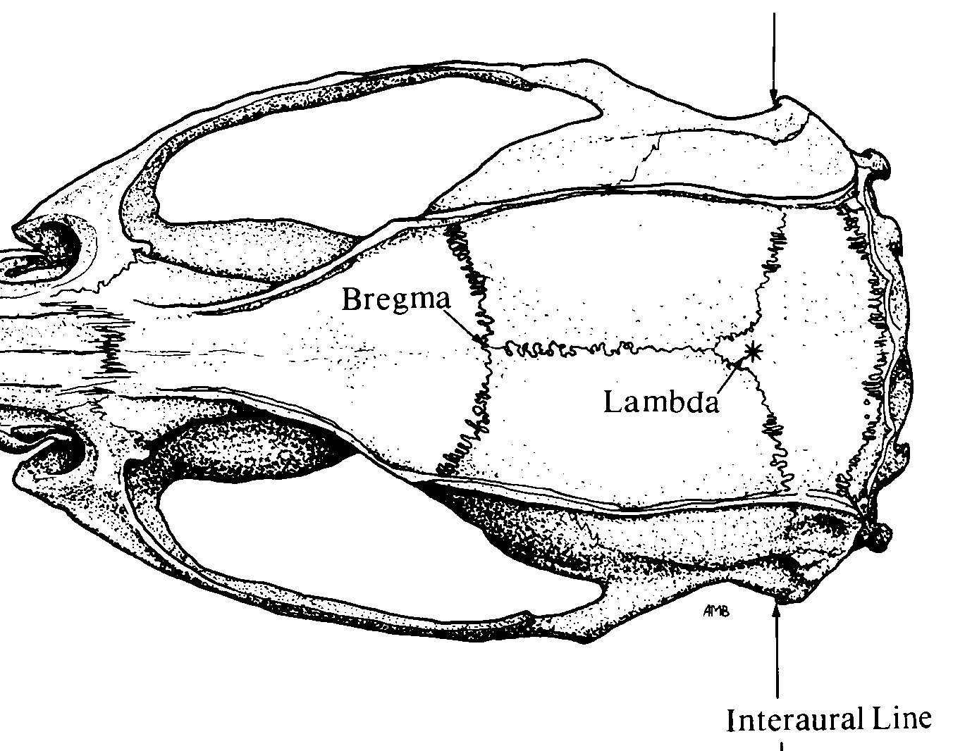

Pinnacle 3-Channel layout
Implant Map
Pin-out
1 GND | 2 EEG2 | 3 EEG3 (EMG-R)
4 COMM | 5 EEG1 | 6 EEG3 (EMG-L)
White out
Bregma
Stereotaxic Coordinates
Location | Bregma | Midline
EMG | Nuchal musc
Parietal | -2 (posterior) | +1.5 (lateral, right only)
❺
❷
Lambda
❹
❶
❻
❸
Nuchal muscle
Adjust ratio $=\frac{Measured X B−L}{Reference X B−L}$

